Slide 1
Division of Transit & Rail
Advisory Committee
(TRAC)
Kick-Off Meeting
January 11, 2013

Slide 2
TRAC
Kick-Off Meeting
January 11, 2013
AGENDA
Introductions
Overview of DTR/TRAC 30 minutes
Break 10 minutes
Sub-Committee Overviews 90 minutes

Slide 3
CDOT Vision
To enhance the quality of life and the environment of the citizens of Colorado by creating an integrated transportation system that focuses on safely moving people and goods by offering convenient linkages among modal choices.
CDOT Mission
To provide the best multi-modal transportation system for Colorado that most effectively and safely moves people, goods and information.

Slide 4
CDOT Fun Facts
104 years old (12 years as DOT)
3600+ employees (DTR 13 employees)
11 Commission Districts/6 Engineering Regions
9,146 State Highway center-line miles/23,061 lane miles
3,447 bridges
5+ million registered vehicles/3.6 million licensed drivers
27.4 billion annual vehicle miles traveled
$1.1 billion (approx) annual budget
  $30 million - transit

Slide 5
CDOT Organization Chart

Slide 6
CDOT Strategy Focus Areas
Improve business processes for better customer service and efficiency.
Use innovation and improved management to get more money to construction from our fixed budget.
Get more out of the existing system.
Develop partnerships with the private sector to augment public funds.
Achieve better transparency and accountability in CDOT’s reporting on budget, project planning and construction, and maintenance activities.
Provide CDOT employees with training and professional development opportunities.

Slide 7
CDOT Current Initiatives
Process improvement projects – LEAN
RAMP (Responsible Acceleration of Maintenance and Partnerships )
  Improved cash management
  Advancing $200-$300M in construction/year (2013-2017)
New Operations Division
HPTE (High Performance Transportation Enterprise)
  US 36 Managed Lanes
  North I-25 Managed Lanes extension
I-70 Mountain Corridor
  Twin Tunnels – east bound bore expansion
  AGS Feasibility Study
  Explore Co-development concept
Transportation Matters – education outreach

Slide 8
Division of Transit & Rail (DTR)
Senate Bill 09-094
43-1-117.5 (3)(a) The Transit and Rail Division shall be responsible for the planning, development, operation, and integration of transit and rail, including, where appropriate, advanced guideway systems, into the statewide transportation system; shall, in coordination with other transit and rail providers, plan, promote, and implement investments in transit and rail services statewide; and shall have the following specific powers and duties:

Slide 9
Division of Transit & Rail (DTR)
Senate Bill 09-094
“Powers and Duties”
To develop a Statewide Transit and Rail Plan
  Integrated in Statewide Transportation Plan
  Identify local, interregional, and statewide transit and passenger rail needs and priorities.
Promote, plan, design, build, finance, operate, maintain, and contract for transit services…
Establish and modify fares and schedules…
Administer and expend state and federal funds…

Slide 10
Division of Transit & Rail (DTR)
Senate Bill 09-094
“Powers and Duties” (cont.)
Coordinate and negotiate with railroads regarding the siting of passenger rail tracks…and the coordination of transit services.
Represent the state with respect to the development of intercity rail facilities…high-speed rail projects…
  Pursue federal funding
  Coordinate with other states
Coordinate and cooperate with Regional Transportation Authorities…

Slide 11
DTR Overview
Interfaces
Integration with the Statewide transportation processes
  STAC
Integration with other CDOT Divisions and Regions
Transportation Commission Transit & Intermodal Committee
CDOT Senior Management Team
Partnership with CASTA/Board
Liaison with Railroads
Member of DUSPA Board
Lead agency for the State Coordination Council

Slide 12
DTR Overview
Division of Responsibilities
Transit Section (Tom Mauser)
  Transit Grants Unit
    Administer FTA Grants to rural and small urban transit entities
    Administer FASTER Transit Grants
  Planning & Infrastructure Unit
    Statewide Transit Data Base
    Transit Asset Management
    Transit Planning
    Intercity Bus
Rail and Special Projects (David Krutsinger)
    Planning Studies/Environmental clearance
    Financing and implementation strategies
    Railroad coordination

Slide 13
DTR Overview
DTR Organization Chart

Slide 14
DTR Overview
Current Initiatives
Transit Section – Tom Mauser
Transit Grants Processes Improvement (on-going)
Develop new Transit Grant Module
  Establish/define Statewide Transit Data Base
FASTER Transit Projects implementation plan

Slide 15
Transit Funding Flowchart

Slide 16
DTR Overview
FASTER Transit Grants
Senate Bill 09-108: Funding Advancement for Surface Transportation and Economic Recovery (FASTER)
  FASTER Safety ($95M annually)
  FASTER Bridge Enterprise ($92M annually)
  FASTER Transit ($15M annually)
FASTER Statewide Transit Projects ($10M annually)
  Statewide, interregional and significant regional projects
  To date, capital only
  Includes DTR administration/FRA Planning Studies matching funds
FASTER Local Transit Projects ($5M annually)
  Local transit projects – CDOT Engineering Regions
  To date, capital only
Formal process
  Call for projects/applications
  Review/score/rank/recommendations
  Transportation Commission approval Feb/contracts July

Slide 17
DTR Overview
Current Initiatives (continued)
Rail & Special Projects – David Krutsinger
State Freight & Passenger Rail Plan
  Interregional Rail Connectivity Study
  I-70 Mountain Corridor Advanced Guideway System Feasibility Study
Statewide Transit Plan
  Input to Statewide Long Range Transportation Plan
Performance Measures

Slide 18
DTR Planning Project Integration

Slide 19
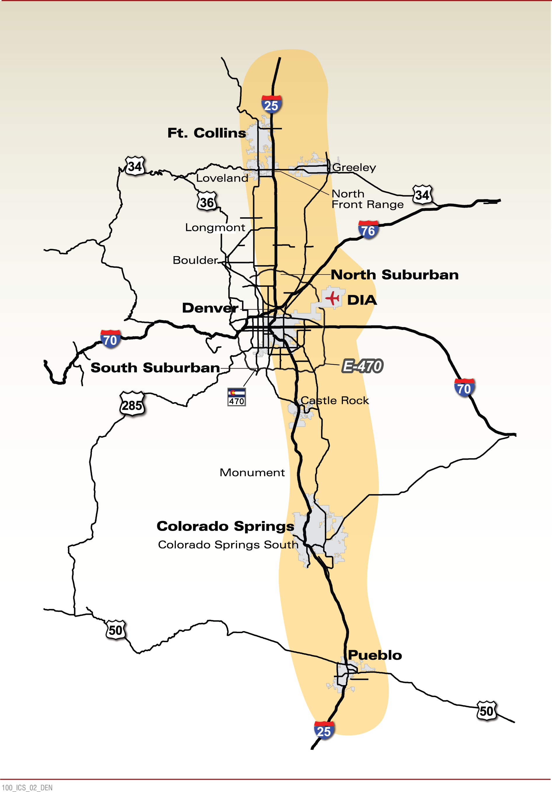
ICS and AGS Map
AGS:
  Eagle County Airport to C-470/I-70
ICS:
  Fort Collins to Pueblo
  C-470/I-70 to DIA
Integrated work
  Technology Consideration
  Ridership Forecasting
  Cost Estimating

Slide 20
DTR Overview
Current Initiatives (continued)
Regional-Commuter Bus Implementation Plan
  CDOT owned and operated service
  Front Range/I-70 Mountain corridor
  Connect existing transit systems
  Service – Summer 2014
Miscellaneous studies/projects
  Transit Asset Management System
  Intercity Bus Plan

Slide 21
Purpose of TRAC
To partner with the Division of Transit & Rail by advising and promoting the Division’s vision, policies and priorities.

Slide 22
TRAC Vision
To preserve and enhance the quality of life and the efficient mobility of people and goods, throughout and beyond Colorado, through the development of safe, reliable, environmentally sensitive, economically sound, with the responsibility to plan, develop, operate and integrate transit and rail into the statewide transportation system and customer-responsive transit and rail networks.

Slide 23
TRAC Major Accomplishments
State Freight & Passenger Rail Plan
Performance Measures Framework
Transit Guiding Principles
FASTER Process Improvements

Slide 24
TRAC 2013 Format
New Member Orientation – DATE??
Quarterly Meetings – Friday 1:00-4:00 (following STAC)
  January 11
  April 12
  July 12
  October 11
TRAC Agenda
  DTR status
  Sub-Committee updates
  Information/Education
  New Issues

Slide 25
TRAC 2013 Sub-Committees
Performance Measures/Asset Management Plan
  David Averill – CDOT PM
Intercity Bus Plan/Regional-Commuter Bus Plan
  John Valerio – CDOT PM
State Transit Plan/Long Range Transportation Plan
  Tracey MacDonald – CDOT PM
Outreach/Education
  Mark Imhoff – CDOT PM
Freight Advisory Committee (representatives)
  Jason Wallis – CDOT PM

